Slide 1


Barcoding Bioinformatics
Part I
Jason Williams
Cold Spring Harbor Laboratory, DNA Learning Center
williams@cshl.edu
@JasonWilliamsNY

Slide 2
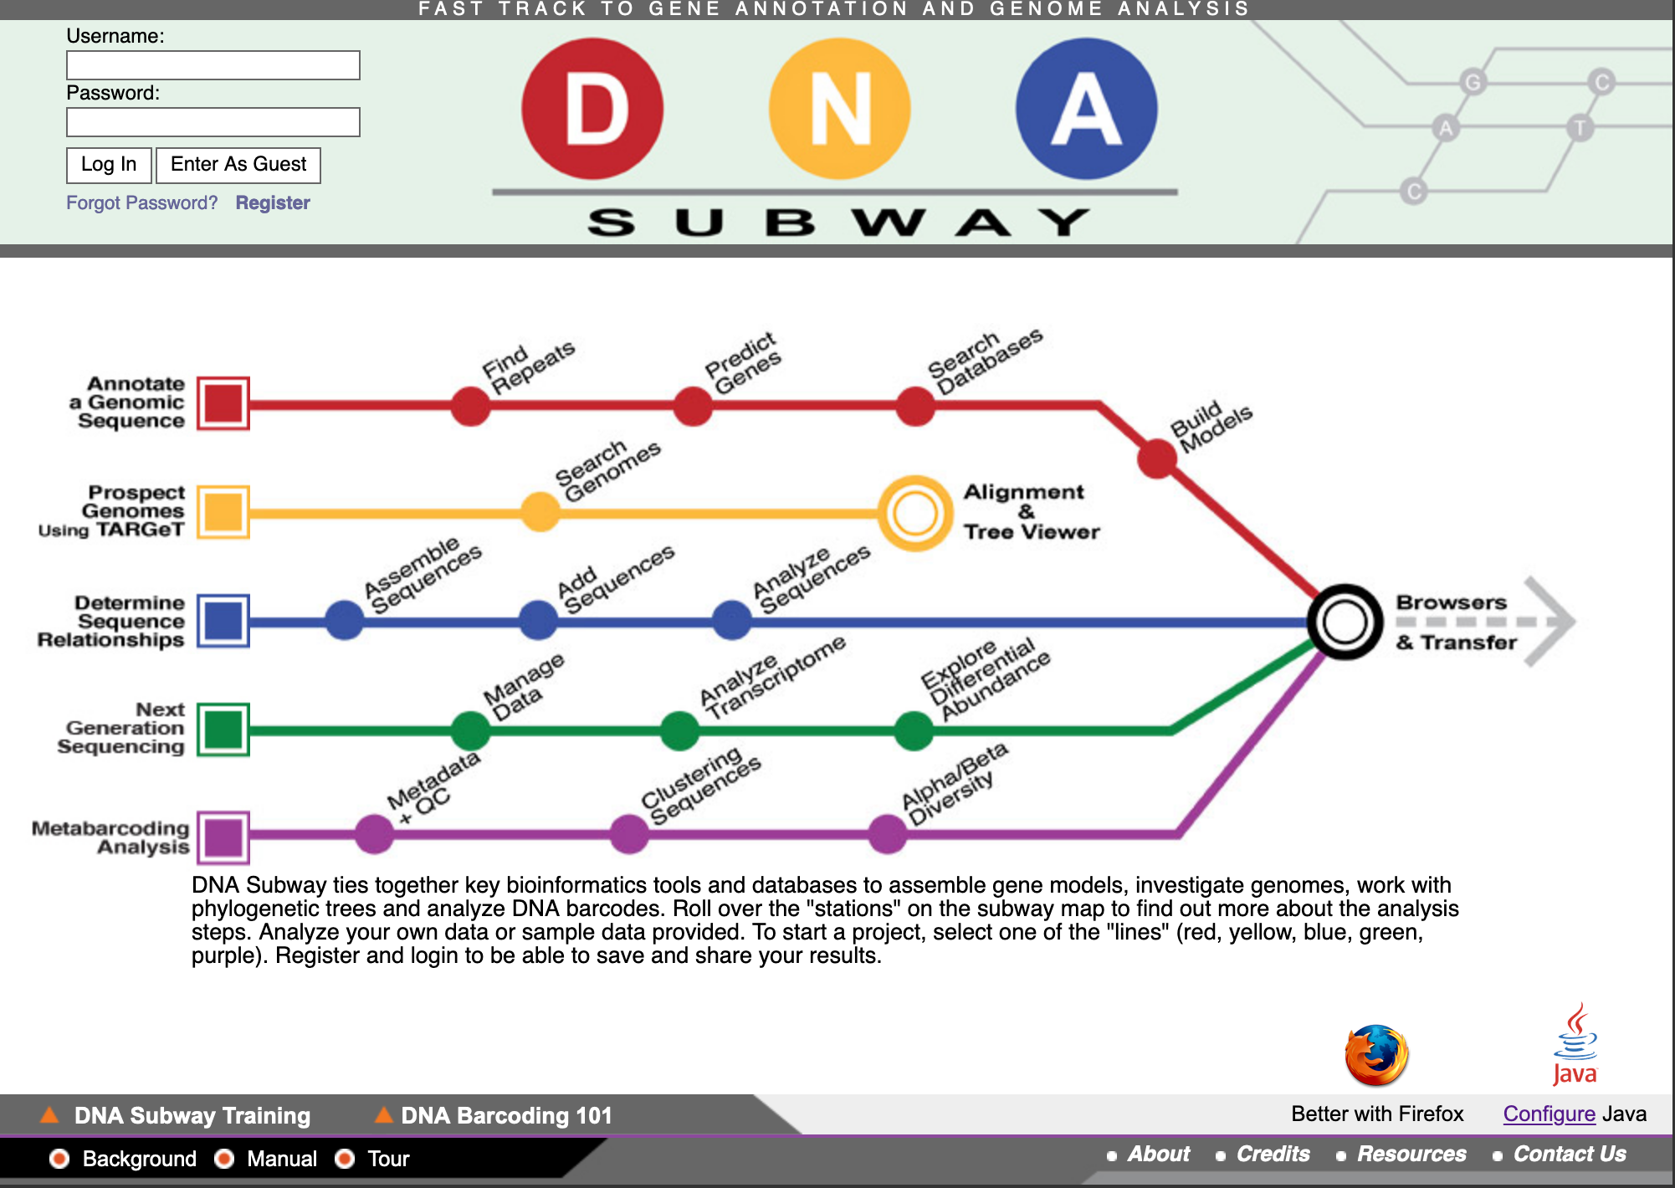
Lab Setup
We will be using DNA Subway – You can get a free account at cyverse.org (optional)

Slide 3
Barcoding Bioinformatics Part I (Background and Sequence Quality)

Slide 4
Bioinformatics is about data
Often, when we are speaking about data in biology, we are talking about DNA Sequence (there are lots of other data, we just won’t be talking about that today)

Slide 5

DNA Sequence
Quick Tour
NCBI Homepage https://www.ncbi.nlm.nih.gov/
Human Genome: https://www.ncbi.nlm.nih.gov/projects/genome/guide/human/index.shtml
Corona Virus Genome: https://mra.asm.org/content/9/11/e00169-20

Slide 6
Introduction to Barcoding

Slide 7
How can you identify an organism using just its DNA?

Slide 8
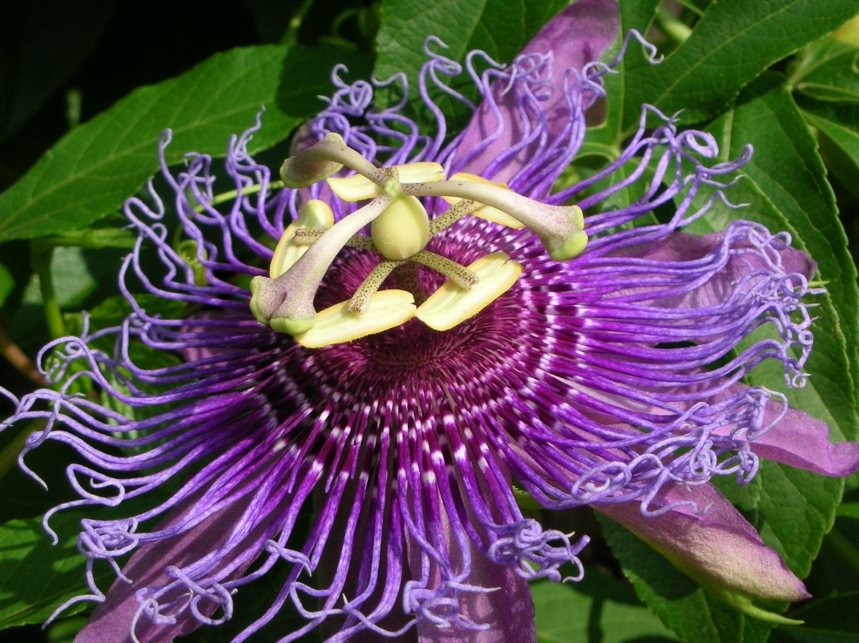

What is DNA Barcoding?

Slide 9
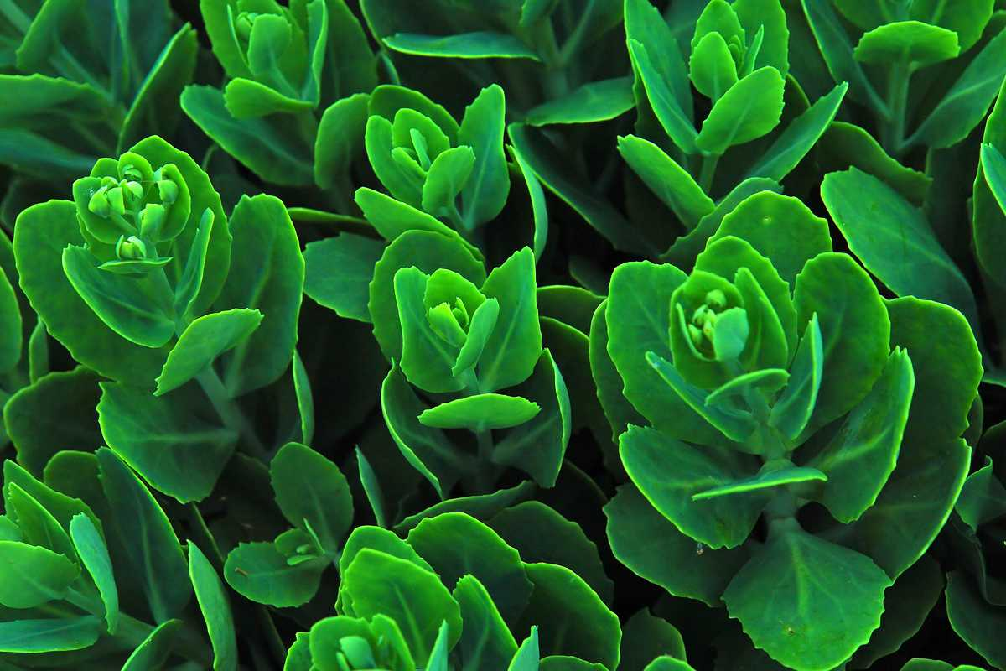



Steps to DNA Barcoding
Organism is sampled DNA is extracted “Barcode” amplified
ACGAGTCGGTAGCTGCCCTCTGACTGCATCGAATTGCTCCCCTACTACGTGCTATATGCGCTTACGATCGTACGAAGATTTATAGAATGCTGCTACTGCTCCCTTATTCGATAACTAGCTCGATTATAGCTACGATG
Sequenced DNA is compared with DNA in a barcode database

Slide 10

The Start of Barcoding

Slide 11
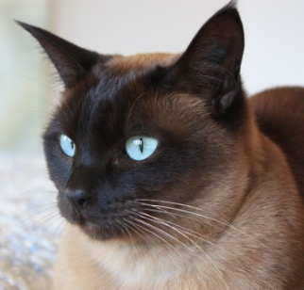

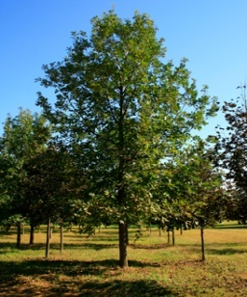
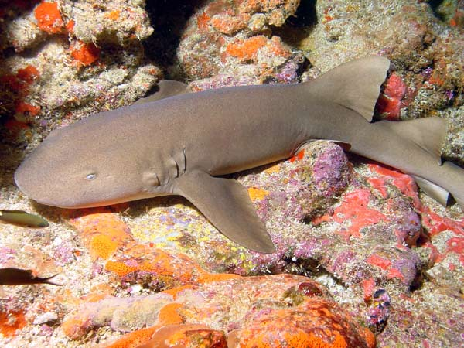
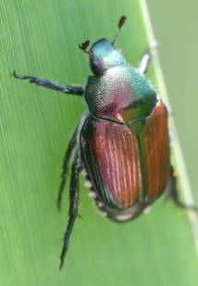
How many species can you name?
How many Animals did you name?
How many mammals?
How many plants?
How many insects?
“Dog”
Canis lupus familiaris
“Shark”
Ginglymostoma cirratum
“Cat”
Felis catus
“Oak Tree”
Quercus alba
“Beetle”
Popillia japonica

Slide 12
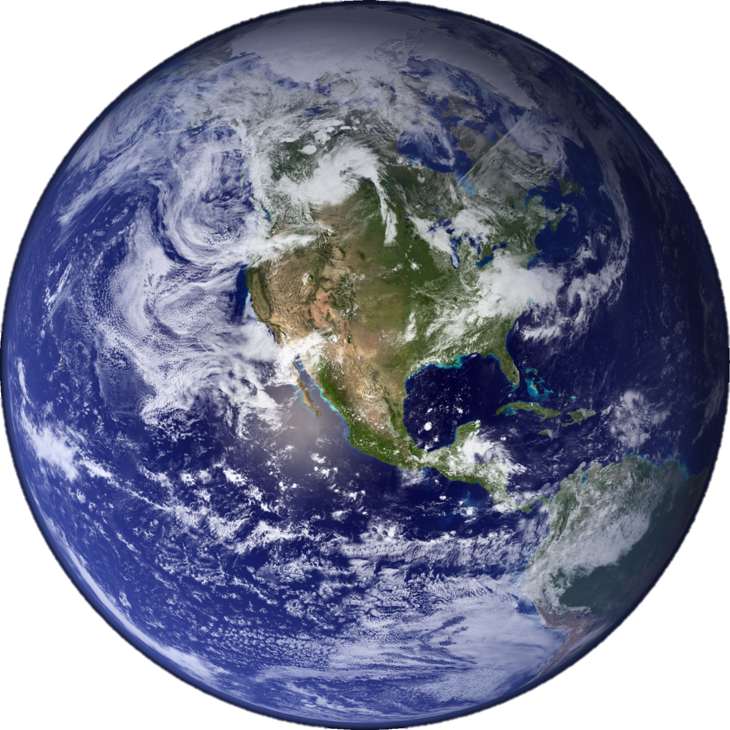
Problem 1: No one know how many species there are.

Slide 13
How many species are there?
Vertebrates | Species
Mammals | 5,490
Birds | 9,998
Reptiles | 9,084
Amphibians | 6,433
Fishes | 31,300
Total | 62,305
Invertebrates | Species
Insects | 1,000,000
Mollusks | 85,00
Crustaceans | 47,000
Corals | 2,175
Arachnids | 102,248
Total (+others) | 1,305,250
Plants | Species
Angiosperms | 281,821
Gymnosperms | 1,021
Ferns and Allies | 12,000
Mosses | 16,236
Green and Red Algae | 10,134
Total | 321,212
There are currently between 1.5 and 2 million described species
It is estimated that this number may represent as little as half of the true number of species
Perhaps more than 1/3 of all species are threatened (IUCN Red list version 2010.1)

Slide 14
Problem 2: Even though there are millions of species, there is also
a lack of agreement on what a “species” means.

Slide 15
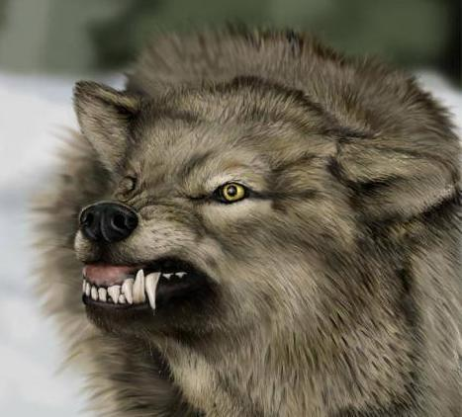
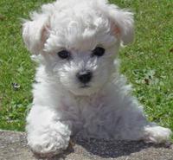
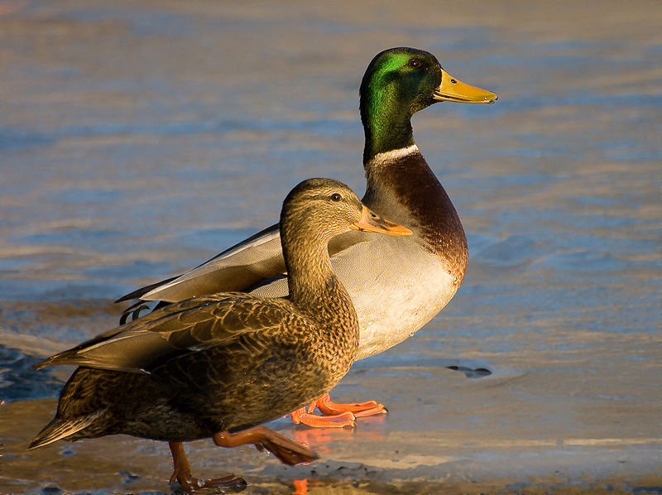
What is a species?
Defining what species are is a
complex task
Dependent on many factors
Interbreeding capabilities
Morphological variation
Ecological context
Genetic similarities
Canis lupus
Canis lupus (familiaris)
Anas platyrhynchos

Slide 16
Problem 3: Current taxonomic methods may be inadequate (or at least too slow) to capture vanishing biodiversity

Slide 17
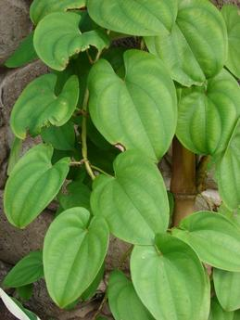
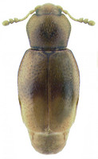
Traditional taxonomies
Leaves alternate proximally, opposite and ultimately decussate distally, 6–16 × 4–13 cm; petiole ca. as long as blade, winged, base clasping, basal lobes stipulate, growing as extensions of wings, less than
1 mm wide; blade 5–7-veined, ovate, glabrous, base typically sagittate, margins entire, apex acute to acuminate. Staminate inflorescences axillary, 1–2 per axil, paniculate, fasciculate; panicles bearing flowers singly,bracteolate, in a zigzag pattern along rachis, internodes less than 2 mm; rachis to 25 cm, secondary axes 1–3(–6), fasciculate, less than 3 cm, each subtended by deltate-ovate bracteole shorter than 1 mm. Pistillate inflorescences solitary, 4–8(–20)-flowered, 6–35 cm, internodes ca. 1 cm
The body form ranges from hemispherical (e.g., Cleidostethus) to elongate oval (e.g., Clypastraea) to latridiid-like (e.g., Foadia). Corylophids are typically dull brown, but some species have contrasting yellowish-brown patches on the pronotum or elytra. The integument is often densely punctured and may be glabrous or bear short, fine recumbent setae. Most corylophid adults can be diagnosed using the following morphological features: Maxilla with single apical lobe; Mesotrochanter short and strongly oblique; Head usually covered by pronotum; Frontoclypeal suture absent; Antennae elongate with 3-segmented club; Procoxal cavities closed externally; Tarsal formula 4-4-4; Pygidium exposed

Slide 18
Sequence is less complex
Leaves alternate proximally, opposite and ultimately decussate distally, 6–16 × 4–13 cm; petiole ca. as long as blade, winged, base clasping, basal lobes stipulate, growing as extensions of wings, less than 1 mm wide; blade 5–7-veined, ovate, glabrous, base typically sagittate, margins entire, apex acute to acuminate. Staminate inflorescences axillary, 1–2 per axil, paniculate, fasciculate; panicles bearing flowers singly,bracteolate, in a zigzag pattern along rachis, internodes less than 2 mm; rachis to 25 cm, secondary axes 1–3(–6), fasciculate, less than 3 cm, each subtended by deltate-ovate bracteole shorter than 1 mm. Pistillate inflorescences solitary, 4–8(–20)-flowered, 6–35 cm, internodes ca. 1 cm
Complex and
Somewhat objective
Simple (A,T,G, or C) and objective
>Dioscorea alata (matK) gene, partial
ATTTAAATTATGTGTCAGATATATTAATACCCCATCCCATCCATCTGGAAATCCTGGTTCAAATACTTCAATGCTGGACTCAAGATGTTTCCTCTT
TGCATTTATTGCGATTCTTTCTCCACGAATATCATAATTCGAAT AGTTTCATTACTCCGAAAAAACCTATTTACGTGATTTCAATTTCAAAAGAAA
ATAAAAGATTTTTTCGAT TCCTATATAATTCTTATGTATTTGAATGTGAATTTGTATTAGTTTTTTTTCATAAGCAATCCTCTTATTT ACGATCAA
GGTCCTCTGGAGTCTTTCTTGAGCGAACACATTTCTATGGAAAAATGGGGCATTTTTTAGTAGTGTGTTGTAATTATTTTCAGAAGACCCAATG
GTTCTTCAAAGATCCTTTTCTGCATTATGTTCGATATC AAGGAAAAGCAATTCTGGTGTCAAAGGGAACTCGTCTTTTGATGAGGAAATGGAGA
TCTTACCTTGTCCATTTTTGGCAATATTATTTTCAATTTTGGTCTCATCCGCATAGGATTCATATAAACCAATTATCAAATTATTCCTTCTGTTTTC
TGGGTTATCTTTCAAATGTACTAATAAATTTTTCCGTGGTAAGGAGTCAAATGTTAGAAAATTCATTTGTAATAGATACTCTTACTAAGAAATT
TGATACCAGAGTTTCAGTTATTGCTCTTATTCG ATCATTGTCTAAAGCGAAATTTTGTACCGTATCCGGGCATCCTATTAGTAAGTCAATATGGA
CAAATTTC TCAGATTTGGATATTATTCATCGATTTGGTTGGATATGTAGAA

Slide 19
Lab: Mosquito Identification

Slide 20
Can we tell the difference between larvae that look (nearly) identical?

Slide 21
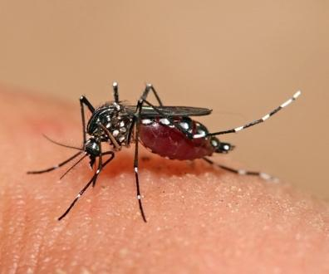
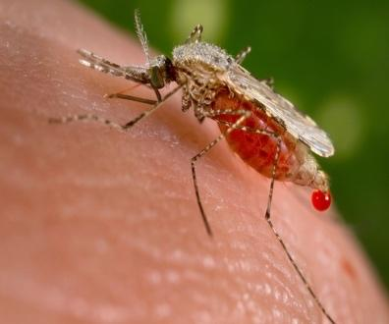
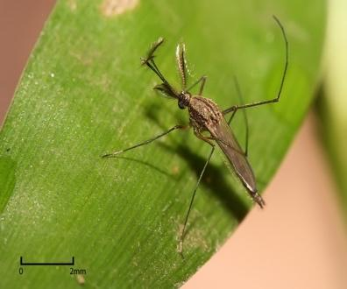
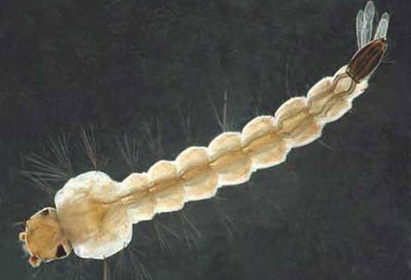
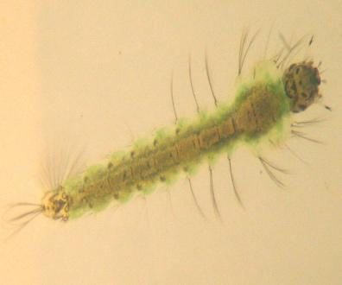
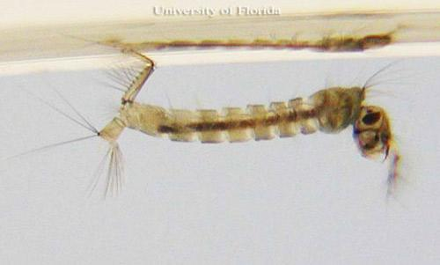
Aedes adult | Anopheles adult | Culex adult
By Muhammad Mahdi Karim - Own work, GFDL 1.2, https://commons.wikimedia.org/w/index.php?curid=11185617 | By Jim Gathany - (PHIL), ID #5814. https://commons.wikimedia.org/w/index.php?curid=799284 | By Muhammad Mahdi Karim - Own work, GFDL 1.2, https://commons.wikimedia.org/w/index.php?curid=7673048
Aedes larva | Anopheles larva | Culex larva
Photograph by Michele M. Cutwa, University of Florida. |  | Photograph by Michelle Cutwa-Francis, University of Florida.

Slide 22
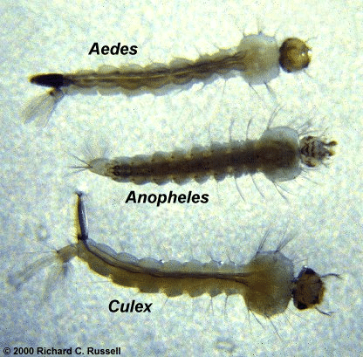

Slide 23
Why does this matter?
Aedes:
Chikungunya
Dengue fever
Lymphatic filariasis
Rift Valley fever
Yellow fever
Zika
Culex:
Japanese encephalitis
Lymphatic filariasis
West Nile fever
Anopheles:
Malaria
Lymphatic filariasis

Slide 24
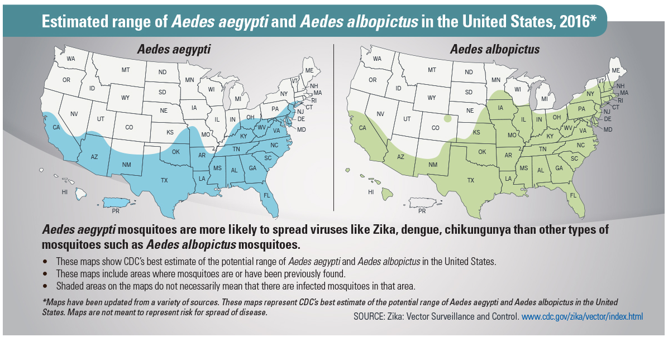
Why does this matter?

Slide 25
Lab: DNA Sequencing Background

Slide 26
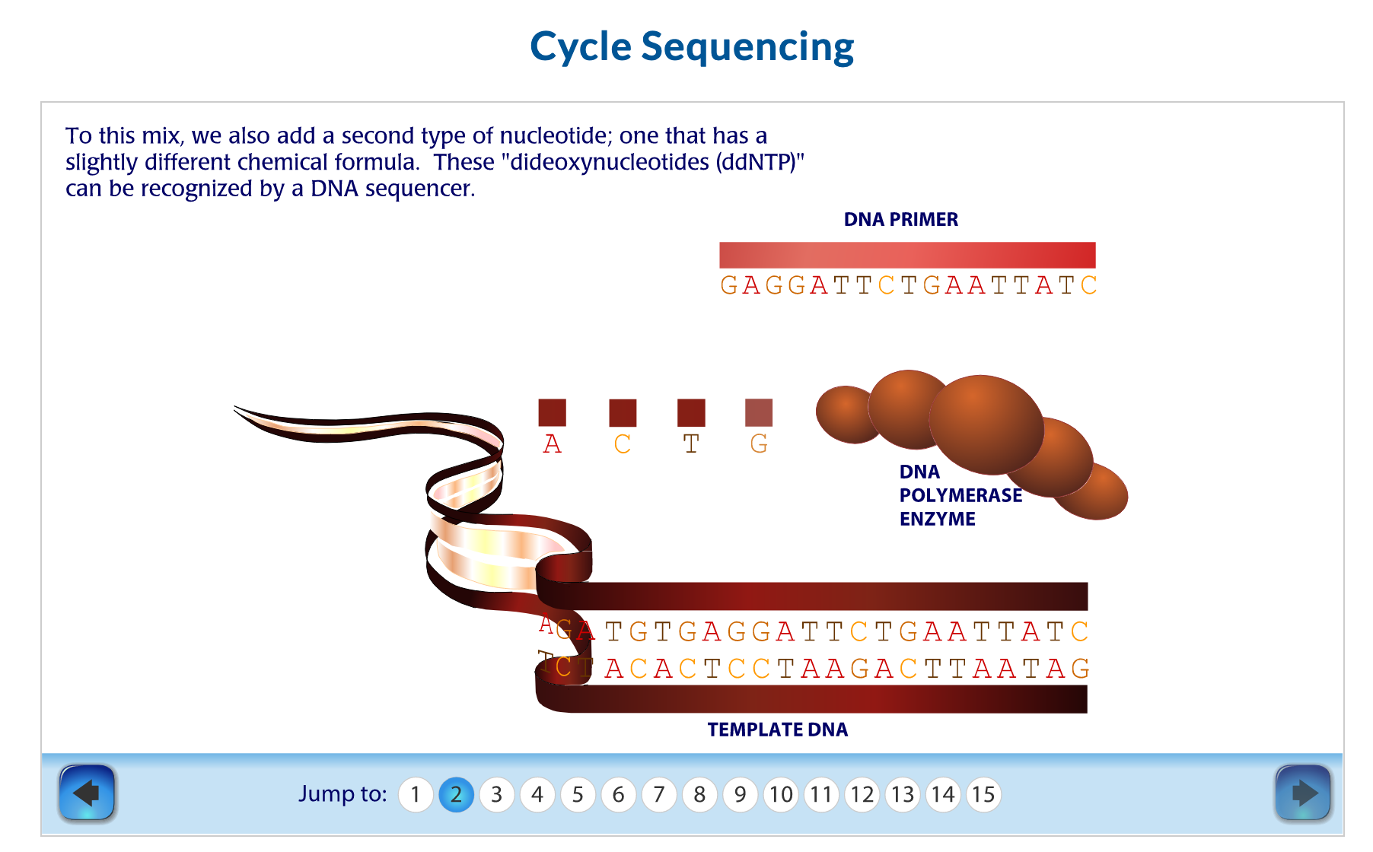
DNA Sequencing
https://dnalc.cshl.edu/resources/animations/cycseq.html

Slide 27
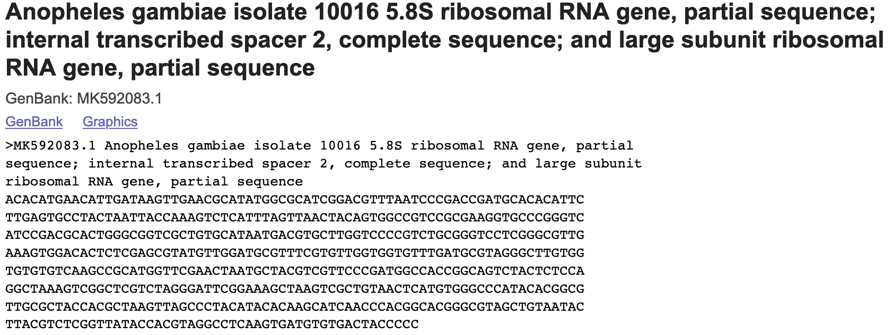
Some Anopheles DNA…

Slide 28
Lab: Creating a DNA Subway Project (follow along in the packet)

Slide 29
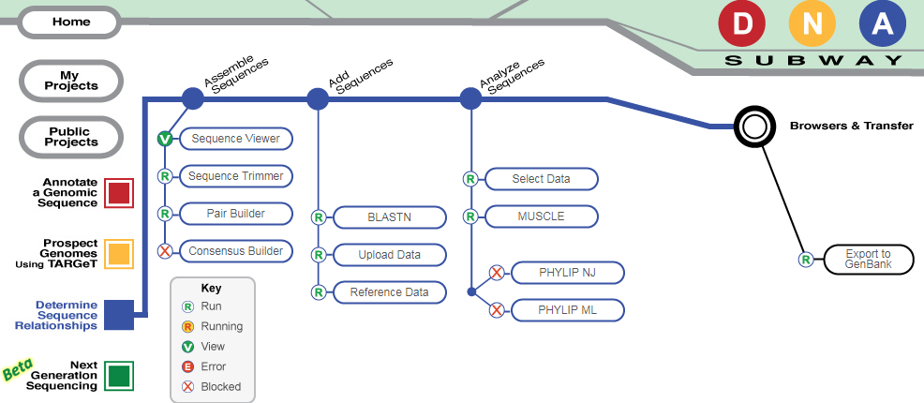
Working on DNA Subway Blue Line

Slide 30
Key Concept: Data Quality

Slide 31
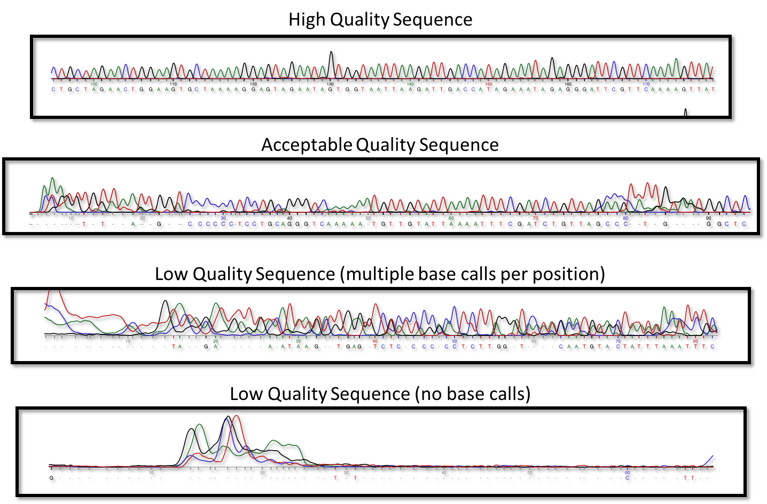
Some sequence examples…

Slide 32
Phred scores…
Phred Score | Error (bases miscalled) | Accuracy
10 | 1 in 10 | 90%
20 | 1 in 100 | 99%
30 | 1 in 1,000 | 99.9%
40 | 1 in 10,000 | 99.99%
50 | 1 in 100,000 | 99.999%

Slide 33
Next time: Comparing sequences with BLAST

